Slide 1
Cook-It - Final Update
Mari Inglese, Nicholas Starace, Yasseen Sabil

Slide 2
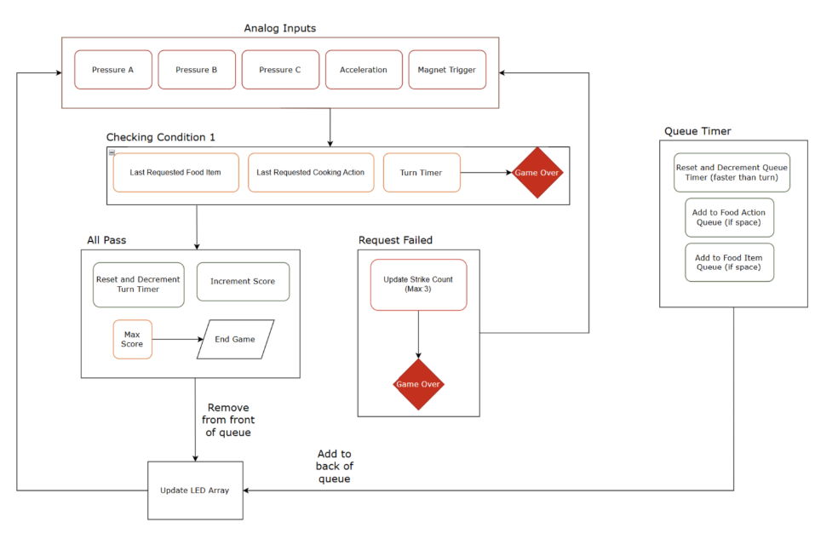
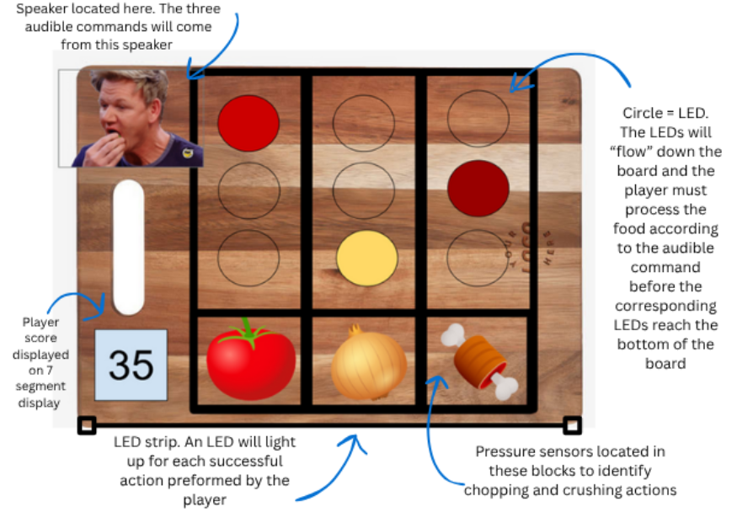
Original Concept
Chop-It – Player performs a chopping motion using a knife on food indicated by the LED queue (pressure)
Crush-It - Player performs a crushing motion using a pestle on food indicated by the LED queue (magnet)
Cook-It – Player tilts the cutting board and scrapes the food into a pan (IMU)

Slide 3
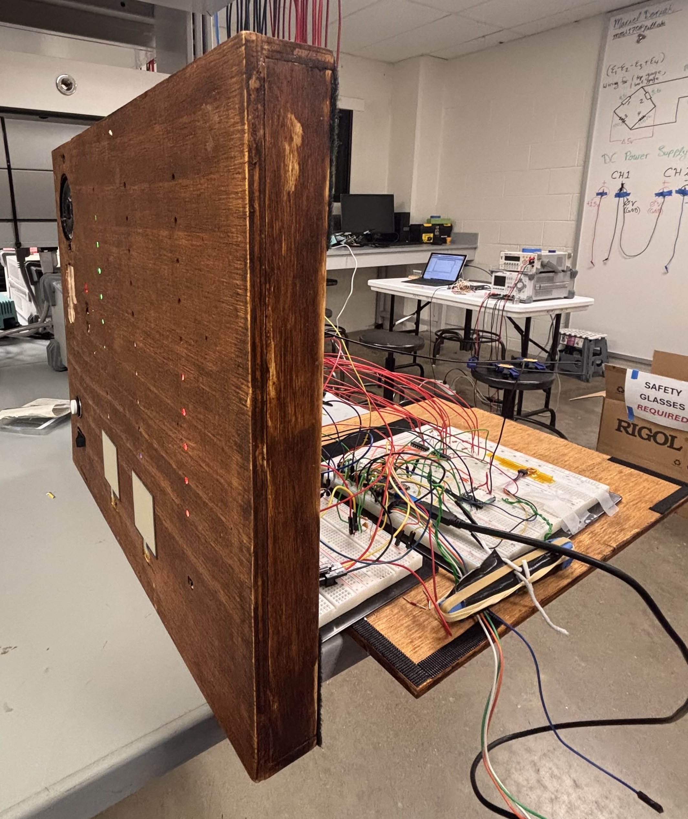
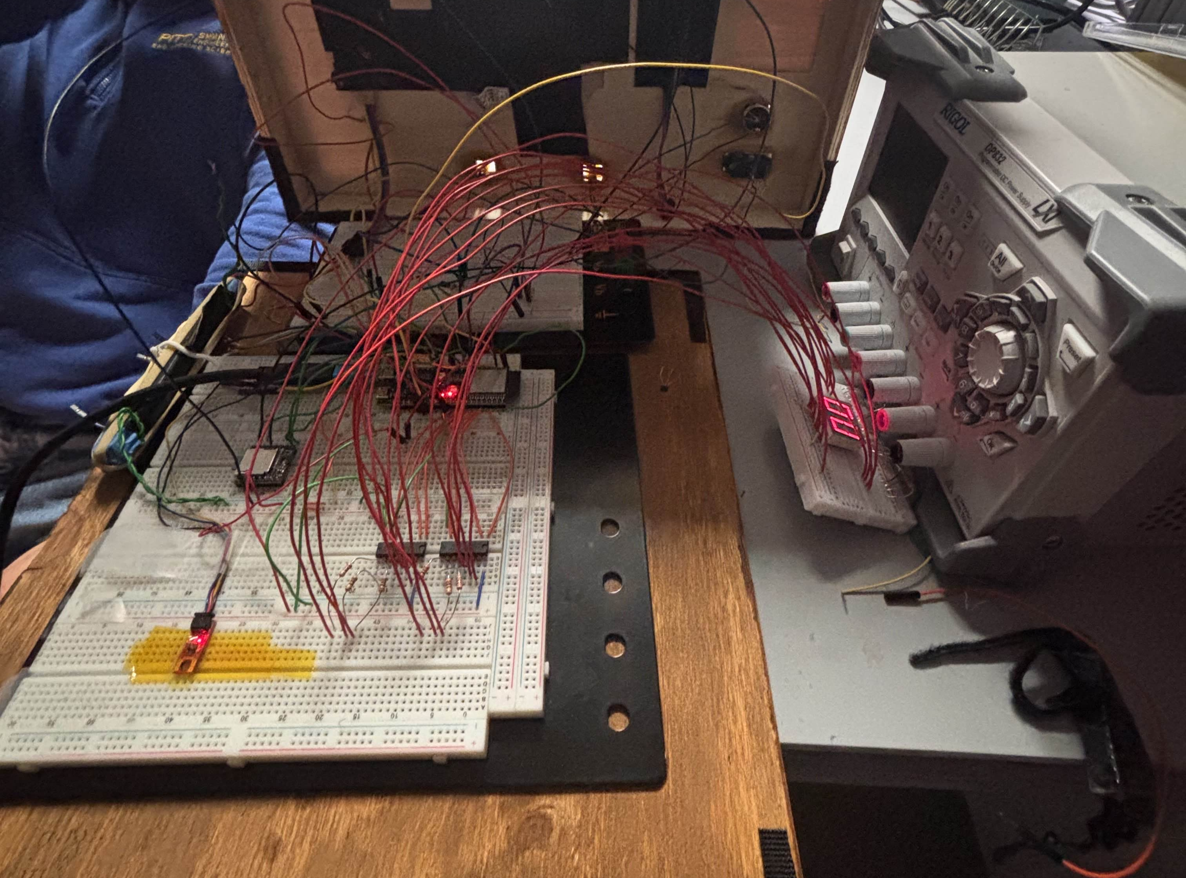
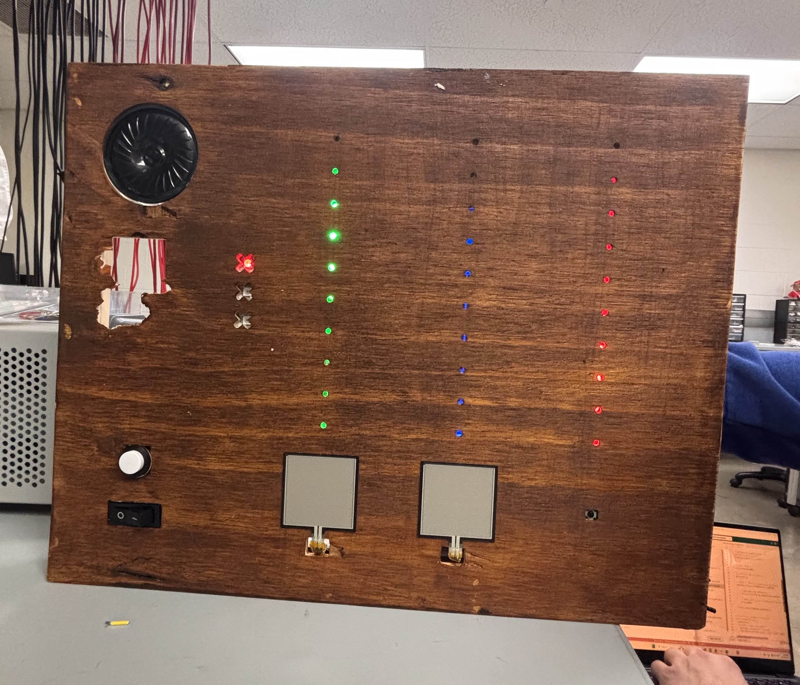
Implemented Features
Stained plywood enclosure crafted using CNC emulating a real cutting board
Full two digit score display
Proper Tetris animation
Audible queues correlated with zones
Three distinct sensor inputs (Pressure sensor, button, IMU)
Toggle power switch
Reset button
Monitor and track strike count for game over

Slide 4
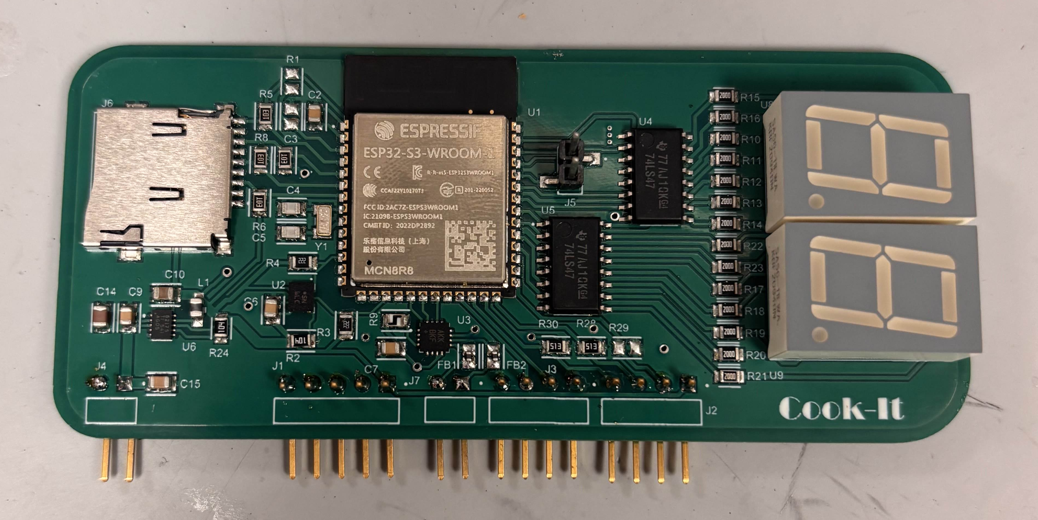
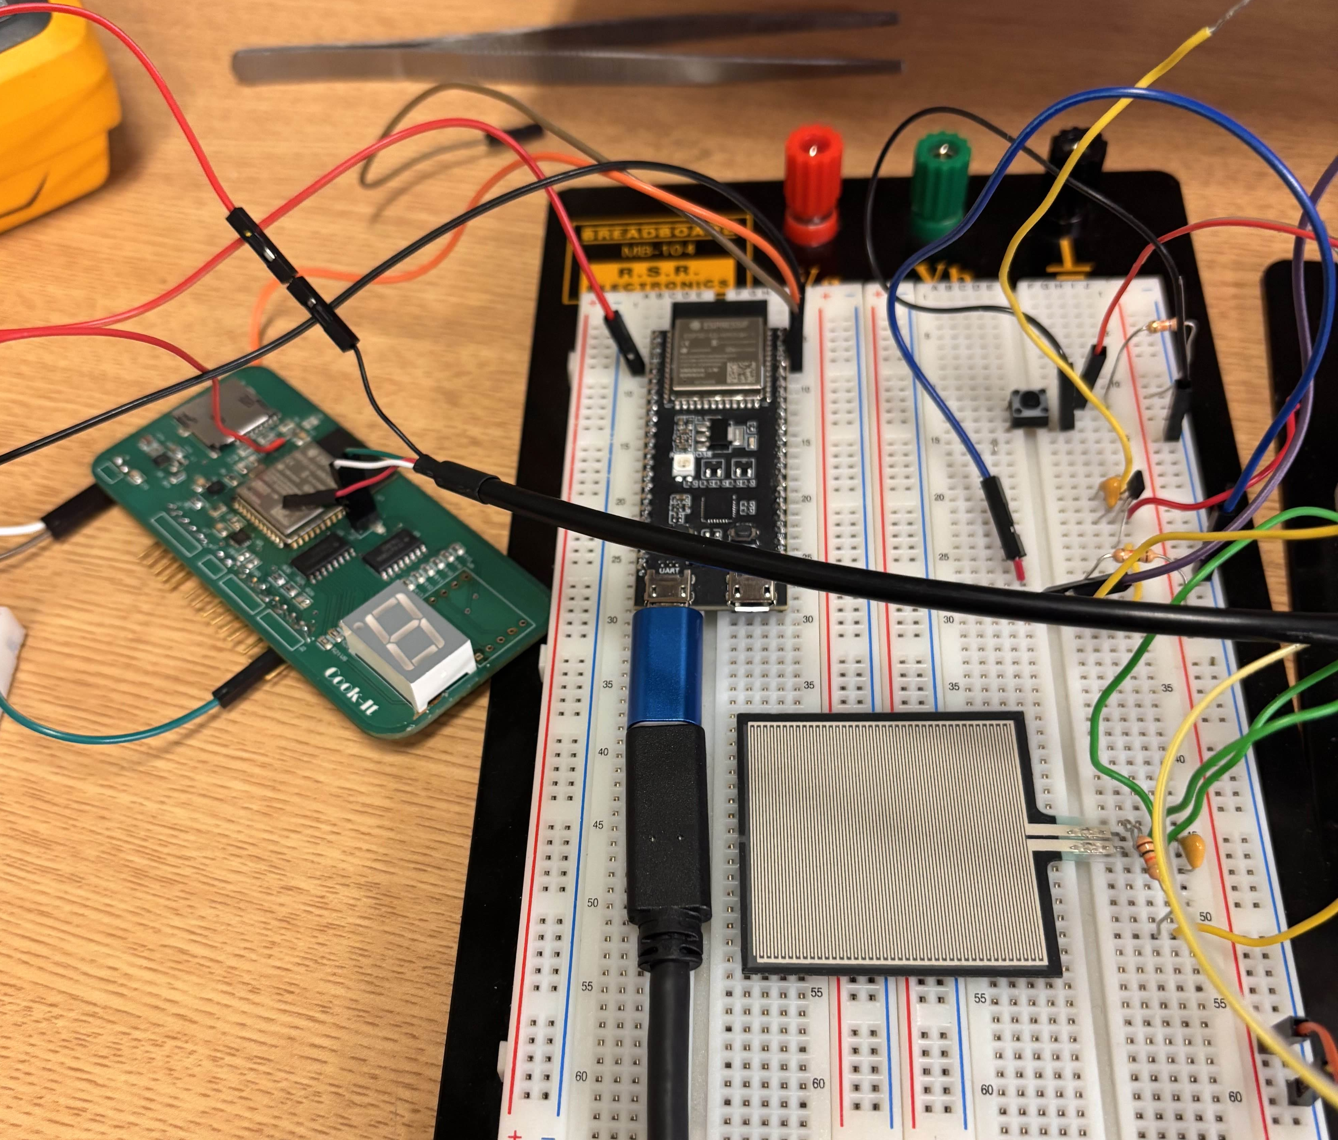
Challenges & Shortcomings
Failed PCB implementation
Wrong regulator package
Filtering capacitor sagging to 2.4 V
Non-constant 3.3 V
Difficulties programming with just Tx, Rx
Version control
LED “tetris” sequences
Sensor input cooldown and triple timing

